Slide 1
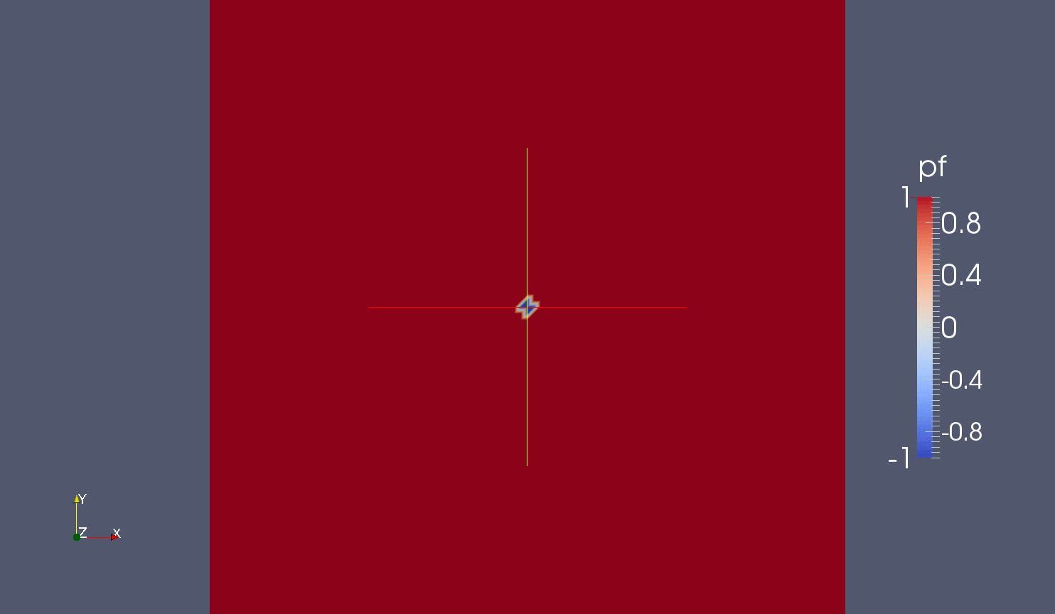
Dendrite growth (reaction-limited case)
Damkohler number ≈ 1 (low reaction rate relatively to diffusion)
Mesh: 50 × 50
Domain: 10.0 × 10.0
Reaction rate: 5.0
Diffusion coef: 0.5
Epsilon: 0.05
dt = 0.005
Timestep = 200

Slide 2

Dendrite growth (diffusion-limited case)
Damkohler number ≈ 50,000
dt = 0.01
Timestep = 80

Slide 3


Dendrite growth (sidebranch)
Damkohler number > 10,000
Random noise was introduced
α is the amplitude of noise
n is random number
dt = 0.01
Timestep = 80

Slide 4
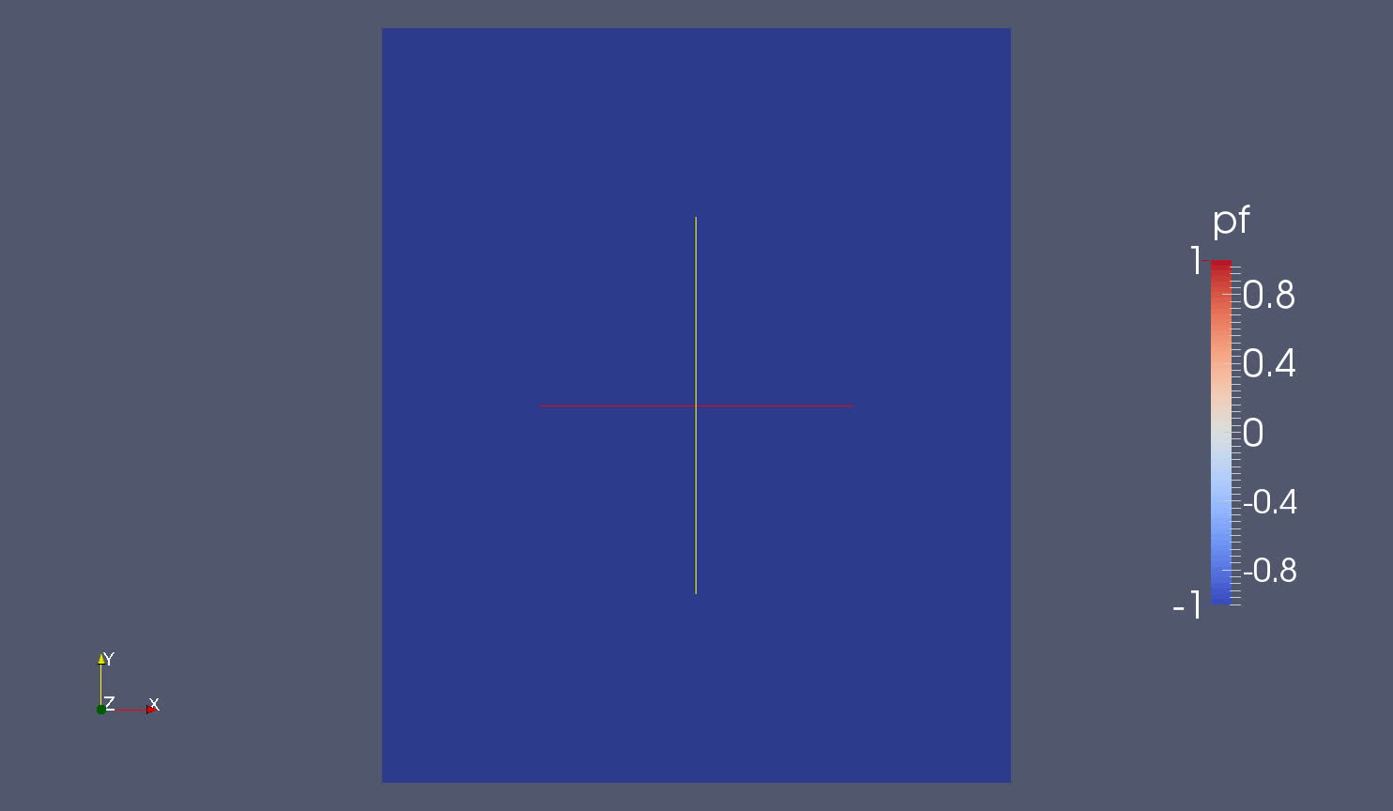
Dissolution
All parameters are the same as sidebranch case with random noise

Slide 5
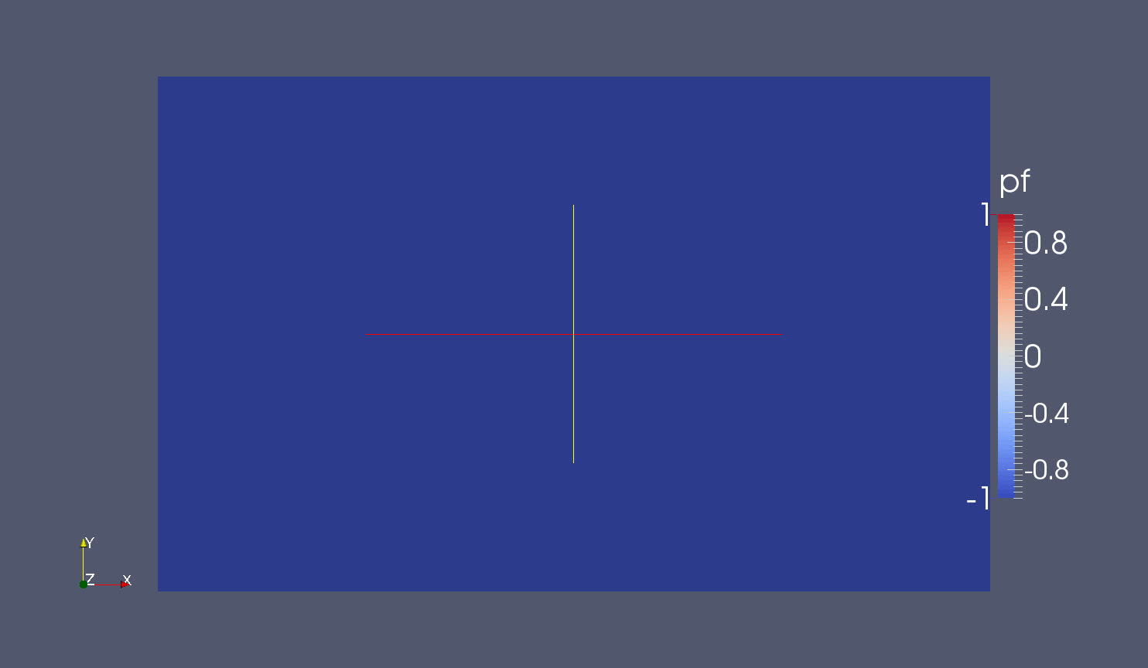
Dissolution (point source)
Dissolution progress is slow
dt = 0.01
Timestep = 100

Slide 6

Dissolution (point source, with convenction)
All parameters are same, except add a convenction term along x axis

